Slide 1
Project: b.a.k.i. (breakthrough automated [kannon] instrument)
Brian Chen
October 7, 2019
ENGI 301

Slide 2
Project Specifications
The b.a.k.i. project involves designing and building a point-defense Nerf autocannon.
Key Features | Logistics
Laser-guided Computer Vision Tracking | Pocketbeagle running OpenCV with RGB data from camera module
Dual-axis cannon rotation | Servomotors for azimuth and elevation, brackets, bearings, and shafts so servo splines aren’t loaded
Launches foam High Impact Rounds (HIRs) | Flywheels powered by brushed motors and MOSFET setup
Backup Joystick Controls | Connecting Wii Nunchuk and PocketBeagle using I2C to map over joystick controls to servo commands

Slide 3
b.a.k.i. as a Compromise
SubSystem | BAKI: Full Spec (What I’m Leaving Out) | b.a.k.i. (Simplification for ENGI 301 Timeline)
Targeting | Computer Vision | Computer Vision
 | Nunchuk Joystick Control | Nunchuk Joystick Control
 | Palm-mounted targeting laser(s) | Targeting via Laser Pointer
 | Backup SAGA-mounted targeting laser
 | Preprogrammed Patterns - ‘Try Me’ mode | --
 | ‘Crank Mode’ - direct physical control | --
Orientation | Dual Axis Servo Rotation | Dual Axis Servo Rotation
 | Servo Clutch System | --
Firing | AirLift System - agitator, blower | --
 | Tank feed | Magazine fed
 | Brushless FWC System | Brushed Motor FWC
 | ESCs for Brushless Motors | MOSFETs for Brushed Motors
Mounting | Back Mounting Harness | --
 | Deployable Carriage System | Stationary Mount
Auxiliary | Targeting Test Bed | Targeting Test Bed
 | Wearability | Nah
Cosmetic | Rotating Tri-barrel | Fixed single barrel

Slide 4
Existing Projects and Proposed Improvements
HIR Launching Mechanism: Flywheel System
Existing Designs
Many Nerf blasters use flywheel systems to launch various foam darts / discs / balls
Works like a baseball pitching machine
Flywheels rotate and impart a frictional force onto projectile, accelerating it to firing speed
Plastic flywheels spooled up by motors housed in a flywheel cage (FWC)
Proposed Improvements / Modifications
Design a custom flywheel cage for improved performance
Use high-performance aftermarket motors
Reverse-engineer cage from HIR dimensions

Slide 5
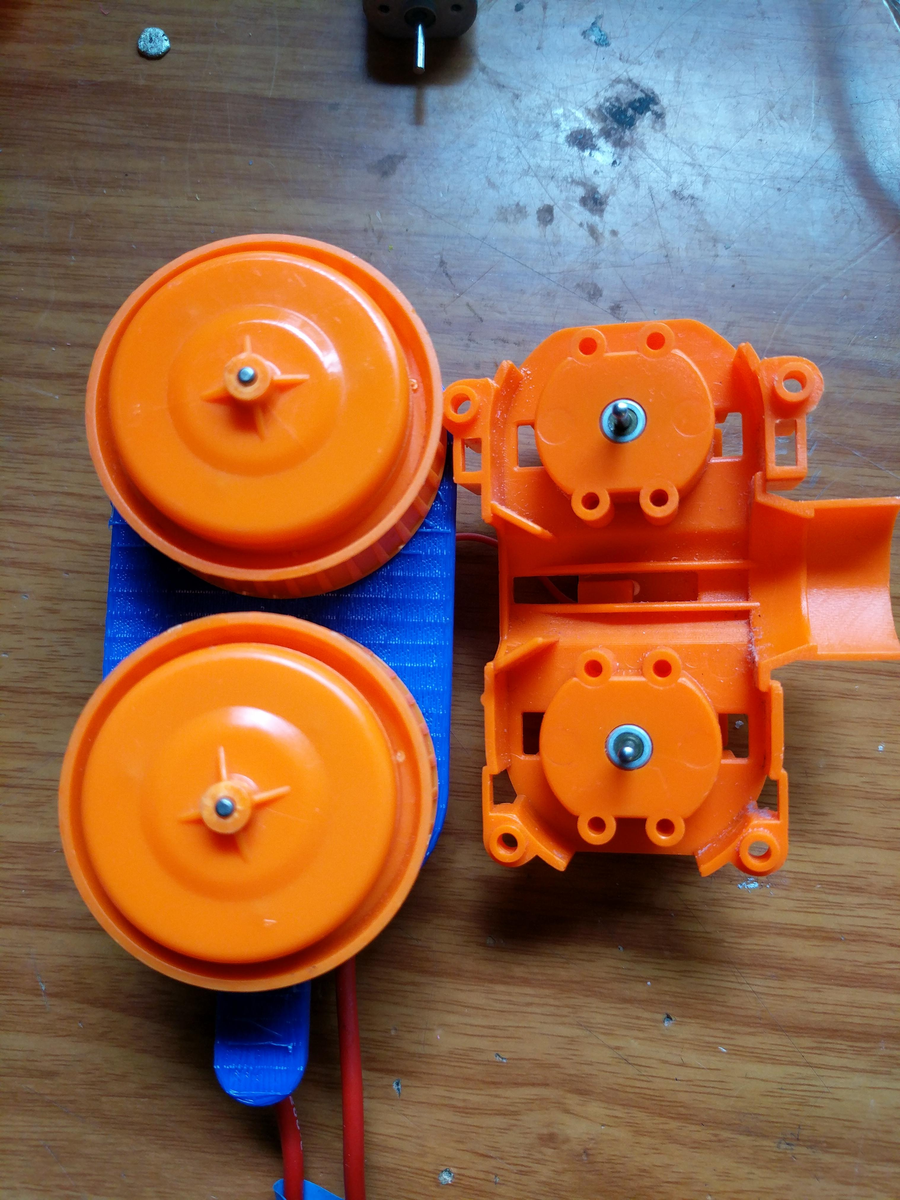
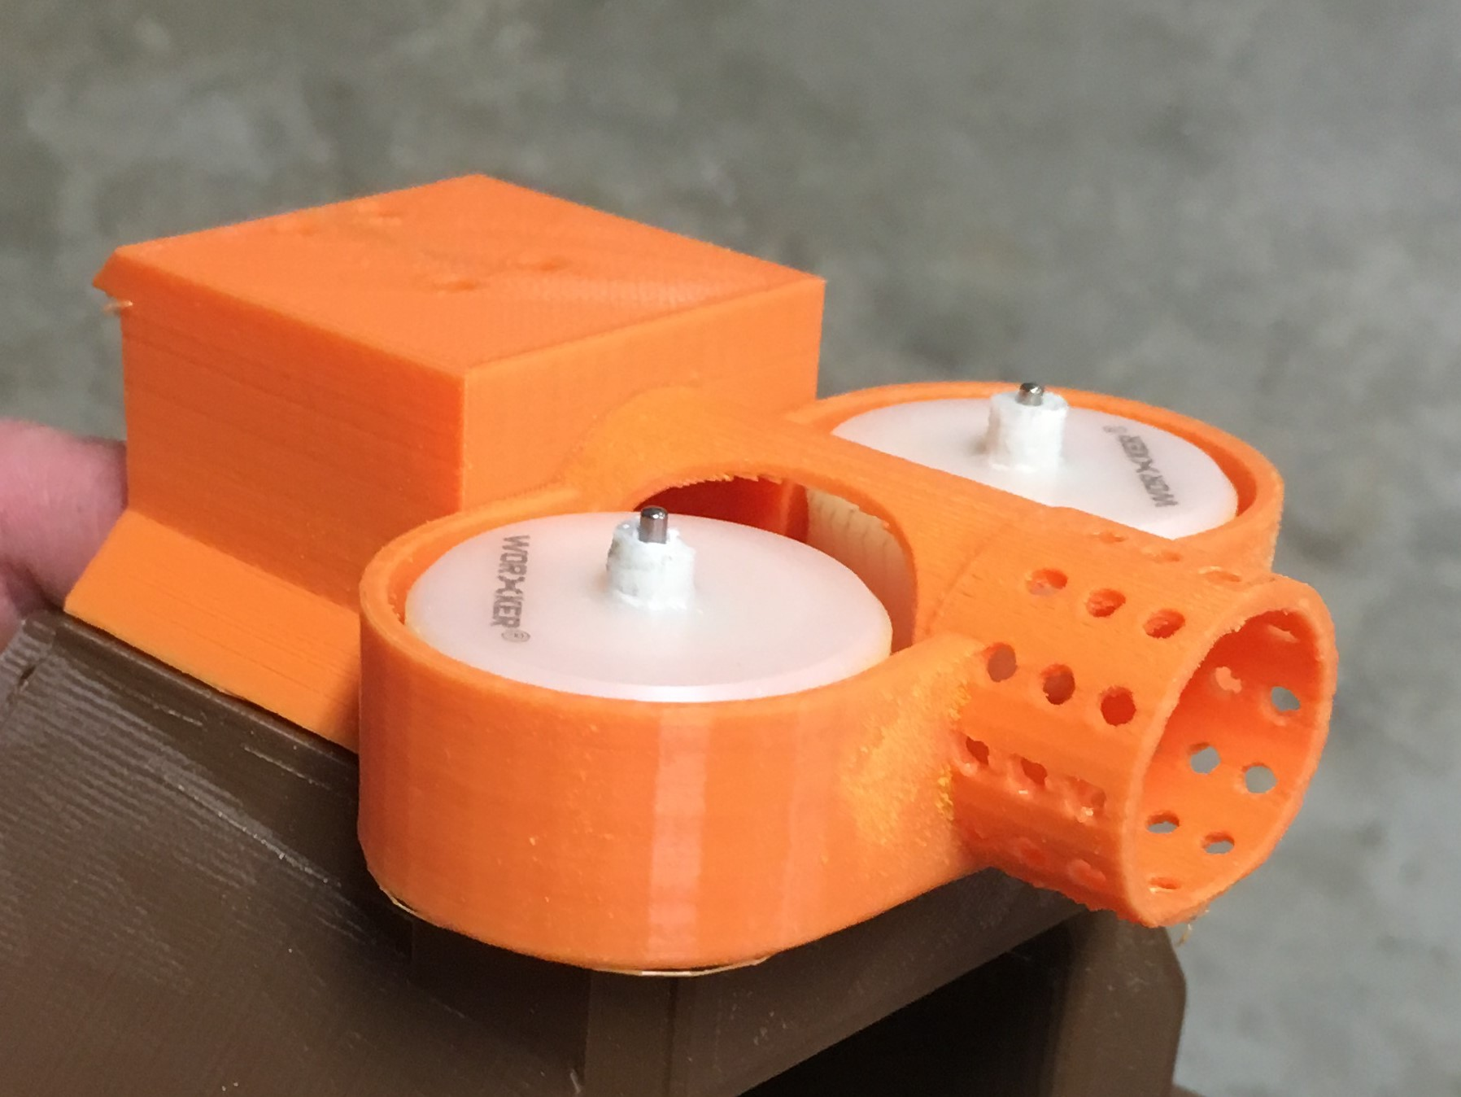
My Custom FWC Design
Examples of Nerf FWCs

Slide 6
Existing Projects and Proposed Improvements
Dual Axis Rotating Point-Defense Turret
Existing Designs
USB Desktop Missile Launcher
Exactly what it sounds like – a novelty toy
Abysmal performance from a USB 5v-driven air piston
PC - controlled with clunky D-pad input
Nerf TerraScout
Basically a nerf blaster mounted to a remote-controlled tank, bulky and underwhelming in performance
Aiming accomplished by turning the entire tank on a dime as opposed to rotating the blaster itself (mounted at a fixed angle; rotation impossible) and difficult due to dual-joystick tank controls
Proposed Improvements / Modifications:
Fast, responsive turret orientation through independent pan / tilt rotation
Achieved through high-speed continuous rotation servos and gear train
Intuitive single-joystick control (achieved with I2C and a Wii Nunchuk controller) as backup to computer vision

Slide 7
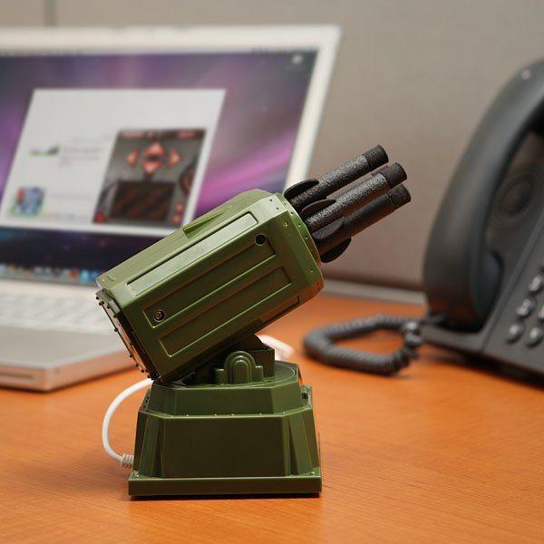
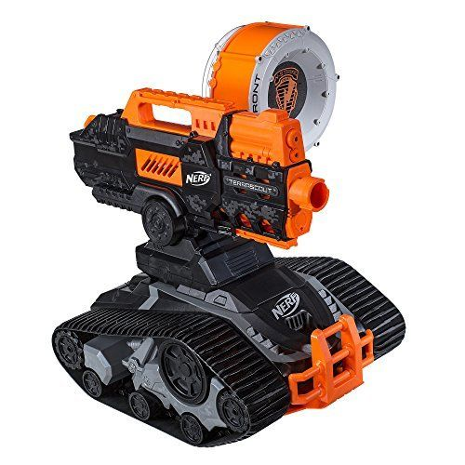
USB Desktop Missile Launcher
Nerf TerraScout

Slide 8
Existing Projects and Proposed Improvements
Computer Vision Guided Targeting
Existing Designs
Project Sentry Gun
Open source code for camera targeting sentry guns
Motor control handled by Arduino, image processing and targeting done on proprietary code (Java – not suitable for Beagle or RPi)
Hacker Shack’s OpenCV Airsoft Turret
Raspberry Pi running OpenCV – open source computer vision program
Extensive documentation on fabrication and coding
Proposed Improvements / Modifications
Follows a simple green dot as opposed to wasting processing power recognizing discrete target objects (like humans)
Targeting will be done with a much more powerful computer: the human brain

Slide 9
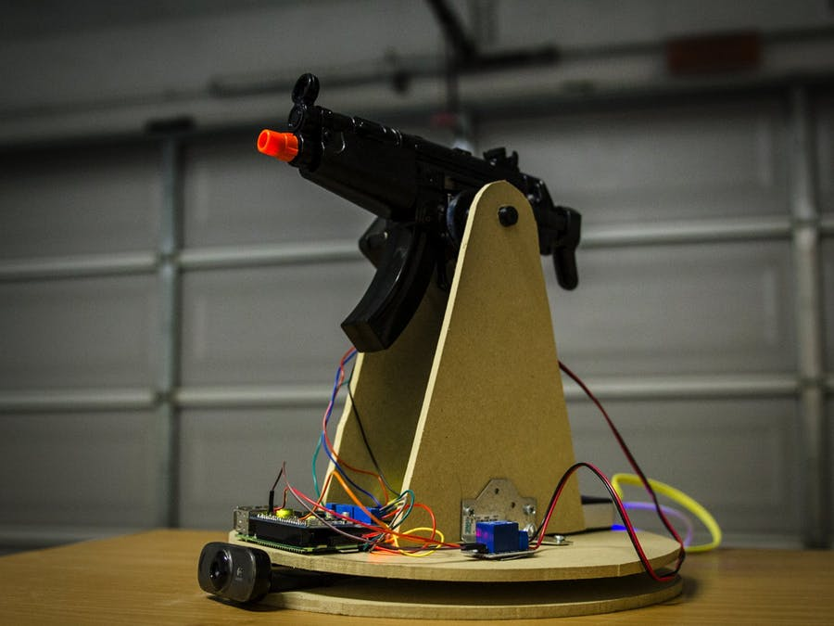
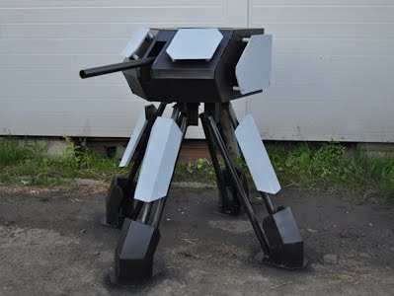
Defense Turret running Project Sentry Gun code
Hacker Shack’s Raspberry Pi Turret

Slide 10
Existing Projects and Proposed Improvements
It is true that much of the technology proposed for use in b.a.k.i. already exists.
However, the project’s value lies in aiming to synthesize all of these ideas into a single package to eventually integrate into a shoulder mounted, wearable combat system.
Additionally, computer vision is an ambitious undertaking in its own right, so in accordance with the project proposal guidelines, I am trading a bit of hardware complexity for software complexity.

Slide 11
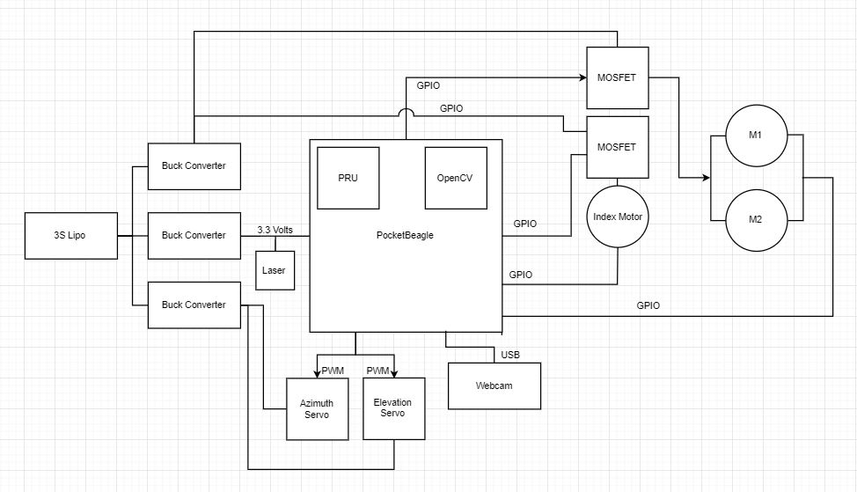
System Block Diagram

Slide 12
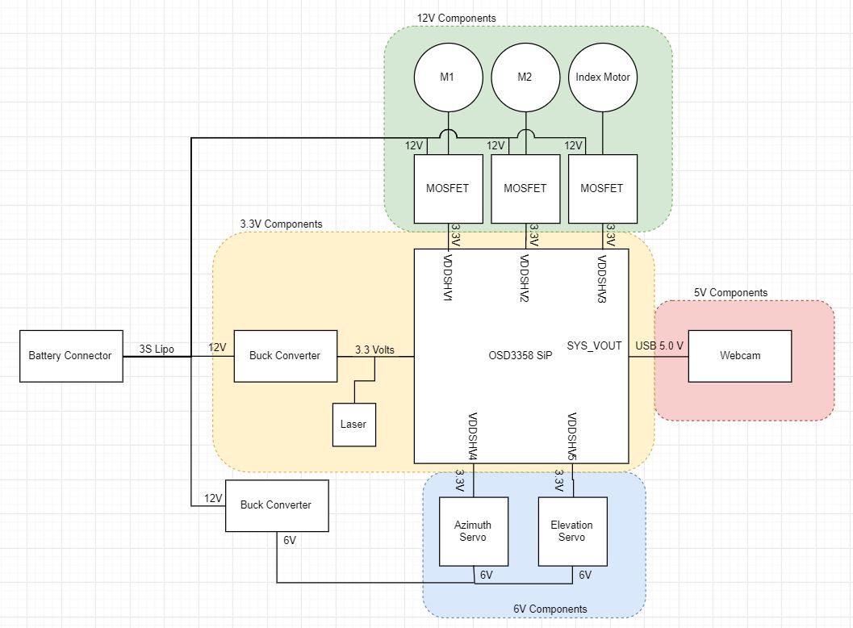
Power Block Diagram

Slide 13
Components / Budget
Component | Need to Buy | Cost
Logitech HD Pro Webcam C920, Widescreen Video Calling and Recording, 1080p Camera, Desktop or Laptop Webcam | 1 | $62
Adafruit Perma-Proto Half-sized Breadboard PCB - 3 Pack! | 1 | $12.50
eBoot 10 Pack LM2596 DC to DC Buck Converter 3.0-40V to 1.5-35V Power Supply Step Down Module (10 Pack) | 1 | $13.99

